Slide 1
The Complex carbohydrates: Starches, cellulose, gums, and pectins
Chapter 9

Slide 2
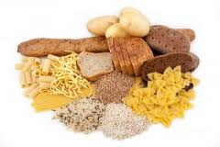
Complex Carbohydrates in the Diet
Complex carbs are found in wide variety of grains and grain-based products
Breads
Cereals
Muffins
Cakes
Cookies
Pastas
Rice

Slide 3
Types of Complex Carbohydrates
Starches
Cellulose
Gums
Pectins

Slide 4
Starches
Most abundant complex carbohydrate in the diet is starch.
Made of 100 to several thousand glucose units linked in chains
Polymer: large molecule that consists of large numbers of small molecular units linked together.

Slide 5
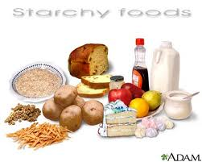
Starches
Sources:
Main source is wheat flour
Rice
Corn
Potatoes
Oats
Rye
Sorghum
Soy
Tapioca
Arrowroot

Slide 6
Starches Have two basic structures:
Linear (amylose)
Branched (amylopectin)

Slide 7
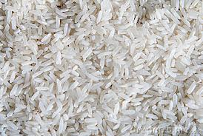
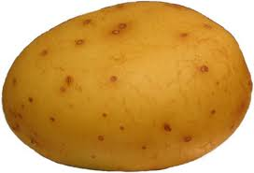
Starches
Granules: packets of starch produced by plants, not soluble in cold water.
Size and shape vary from plant to plant.
Rice has the smallest granules
Potatoes have the largest granules
Starch granules are a mixture of amylose and amylopectin molecules
Varying ratios cause each type of starch to act differently in food mixtures.
Starches composed of mainly amylopectin are called waxy starches.

Slide 8
Cellulose
Polysaccharide made from large amounts of beta-D-glucose.
Humans lack the digestive enzymes needed to break the bonds in cellulose molecules.
Known as fiber
Forms rigid structure in plants
Strings in celery
Membranes surrounding kernels of corn

Slide 9
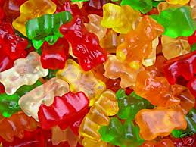
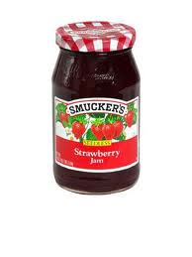
Carbohydrate Gums and Pectins
Carbohydrate Gums
Pectins
Polysaccharides that are soluble in water and extracted from plants.
Thicken and stabilize mixtures
Traps color and flavor
Provide stability and texture for foods such as salad dressings and gummy candies.
Used as food additives (handout)
Complex carb found in plan cells and made of chemical derivatives of sugar called sugar acids.
Naturally occurs in fruit
Produce a strong gel
In presence of sugar, pectin molecules will dehydrate
Acid will create a thickened structure
Jams and jellies.

Slide 10
Provide structure Bind Thicken What are some starch based foods that relate to each of the above functions?
Functions of Complex Carbohydrates in food Preparation

Slide 11
Provide Structure
Flour provides majority of structure of baked goods and many other food products.
Cereals retain their shape due to starch content
Starch thickens when heated and gels when cooled
Cellulose forms the framework for fruits and vegetables
Pectins and gums responsible for the texture of jams, jellies, ice cream products, and gummy textured candies.

Slide 12
Bind
Binding agents are substances that tend to hold two other products together.
Amylose molecules will work better than amylopectin at holding batters to vegetables and meats during deep frying.
Carageenan is a gum used as a binding agent.
Guar and xanthan gums are used to improve the consistency of gluten free baked goods.
The starch in flour binds the batter to onion rings so it does not separate from onions during frying.

Slide 13
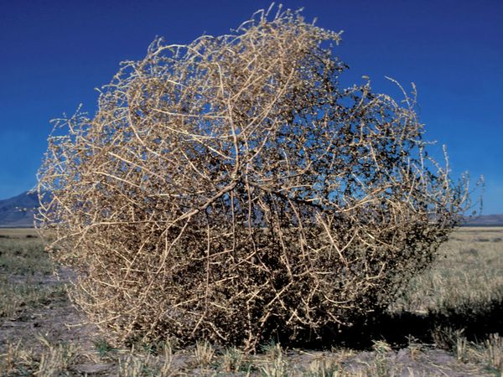
Thicken
Starch
Thicken liquids
Molecules of arch are chemically altered as they swell and take up water
When heated, starch molecules relax and hydrogen bonds form between starch molecules and water.
Gelatinization occurs which means to thicken a liquid with starch.
The temp. at which maximum swelling occurs in the gelatinization point.
Too much heat can cause starch to loose thickening ability.
Starch molecules are much larger than water molecules, and are like tumbleweeds

Slide 14
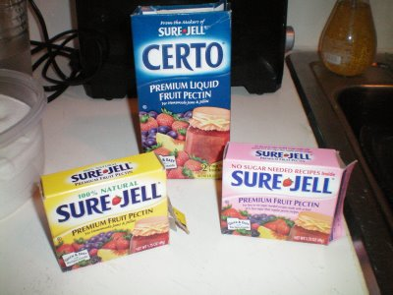
Thicken
Pectin
Used to thicken jams and jellies
Liquid and powdered pectin are available for thickening homemade jams and jellies. Commercially, pectin is used as a thickener and stabilizer in such foods as ice cream and candy

Slide 15
Types of starch and liquid mixtures
Sols- thickened liquids
Pancake and waffle mix, white sauce and gravy
Pastes- thickened mixtures of starch and liquid that have very little flow.
Gravy (starch combined with water or milk)
Gels- a rigid starch mixture
Pudding
Jell-O
Slurries- uncooked mixtures of water and starch

Slide 16
Physical properties of starch and liquid mixtures
Retrogradation
Viscosity
Stability
Opacity versus Translucency
Texture

Slide 17
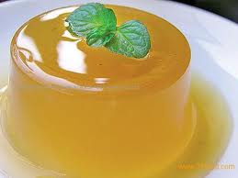
Retrogradation
Firming of a gel during cooling and standing
Occurs because starch granules are trying to return to the structure they had before cooking.
Desirable when it causes a gel to thicken during cooling
Undesirable if it continues to the point that cracks form in the gel.
Syneresis is the term used for water leaking from gel over time
Ex. liquid that separates from mustard
Acids break down starches and gels which reduces the thickening of starch.

Slide 18
Viscosity
The resistance of a mixture to flow
Measured by line spread sheets (see handout)
The more solid that is present the more viscosity there will be.
http://www.youtube.com/watch?v=3KU_skfdZVQ

Slide 19
Stability
Ability of a thickened mixture to remain constant over time and temperature changes.
A stable sauce can be frozen and reheated with no change in in appearance or taste.
Waxy maize starch is a clear, soft paste that is as thick hot as cold.
Cornstarch is not stable in prolonged heat
Would be better to use flour in a gravy mixture because it would stay smooth over time.

Slide 20
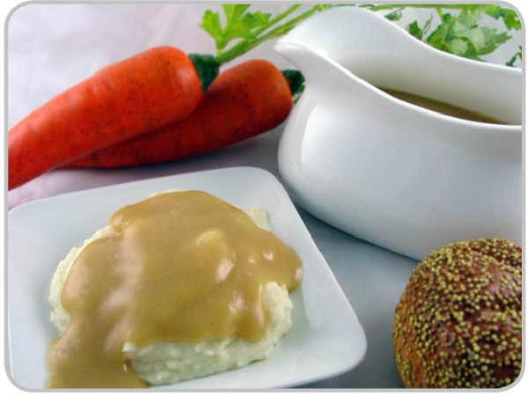
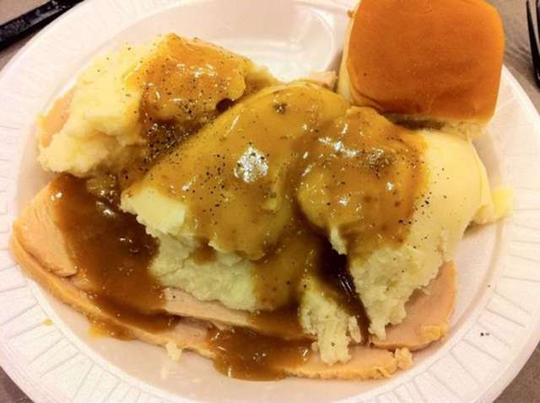
Opacity vs. Translucency
Opacity: how much an object blocks light
Gels made with wheat starch
Translucency: how much light can pass through an object
Gels made with cornstarch, potato starch, and arrowroot.

Slide 21
Texture
Ex. You can use cornmeal to thicken gravy but most people would not like it because it would feel gritty and not smooth.
Ex. Whole wheat flour would also be gritty

Slide 22
Modified Starches
Starches that have been changed structurally by chemical or mechanical means.
Most common sources of modified starches:
Wheat
Corn
Soy
Can modify
Viscosity
Mouthfeel
Appearance
Cross-linked starch: Changed chemically so cross-bonding or cross-linking takes place between starch molecules.
Many frozen entree's and instant, quick-mix foods would not be possible without these starches

Slide 23
Thickening sauces with Starch
Cold water paste
Starch and fat
Starch and sugar

Slide 24
Corn starch and water
http://www.youtube.com/watch?v=amfjWWMg9c0

Slide 25
Cold Water Paste
Method for preventing lumps when thickening
Quickly stir starch while adding an equal amount of cold water.
Once smooth, more water can be added and and put on heat t begin the thickening process.
Can be used for soup stock or gravy.

Slide 26
Starch and Fat
Separate starch granules with melted fat.
Add equal amount of starch to hot melted fat and stir.
Then the liquid can be added slowly.
Constant stirring
Used to make white sauce and gravy from meat drippings.

Slide 27
Starch and Sugar
Combine starch and sugar
Gradually add liquid
Constant stirring
Sugar helps separate the starch granules and keeps them from sticking.

Slide 28
Nutritional Impact of complex Carbohydrates
Like sugar, digestible starches provide 4 kilocalories of energy per gram.
Starch is the most economical and abundant source of calories available to people.

Slide 29
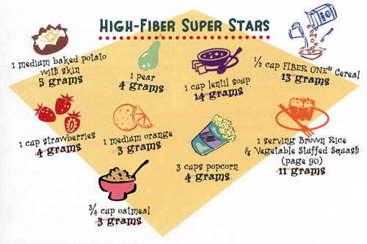
Fiber, Bran, and Bulk
Cellulose (fiber) provides bulk in the diet.
Helps make you feel full
Aids in digestion and elimination of waste.
Indigestible
Sources
Fruits
Vegetables
Grains

Slide 30
Nutritional Functions of Carbohydrates
Main function of carbohydrates:
Provide energy for bodily functions
Other functions:
Provide bulk for the digestive process
Tie up bile acids, decreasing their reabsorption
Lower cholesterol levels in blood
Promote the utilization of fat
Should not be routinely consumed over the recommended daily amount.

